Slide 1
SP-GQE: Semantic Pruning on Graph-structured Query Expansion
Robert Oprescu
Motivation · Method · Results
HotpotQA distractor — 680 questions · 28 seeds

Slide 2
Outline
Motivation & hypothesis (H1)
Method: per-question RDF graph + two SPARQL branches
Top-down pipeline logic (fusion & semantic pruning)
Fair baselines & evaluation design
Results at scale (680 questions, 28 seeds)
Heatmap (n, τ) selection & graph-query validity
SPARQL query + result samples

Slide 3
Motivation
Multi-hop QA needs evidence across paragraphs — dense RAG may miss bridge facts.
Graph-augmented systems vary in where structure acts (index vs query time).
SP-GQE: lightweight, training-free, query-time SPARQL on an in-corpus co-occurrence graph.
No external KB — only HotpotQA’s 10 distractor paragraphs per question.
Fair comparison: same FAISS index, MiniLM embeddings, Groq reader for all pipelines.
680
questions evaluated
28
random seeds
50%
bridge / comparison stratified

Slide 4
Hypothesis H1
H1: SP-GQE improves token F1 vs V-RAG on bridge questions (multi-hop linking).
Null: on comparison questions, dense retrieval often suffices.
Diagnostics: Do branches complement? Does τ pruning trade P for R?

Slide 5
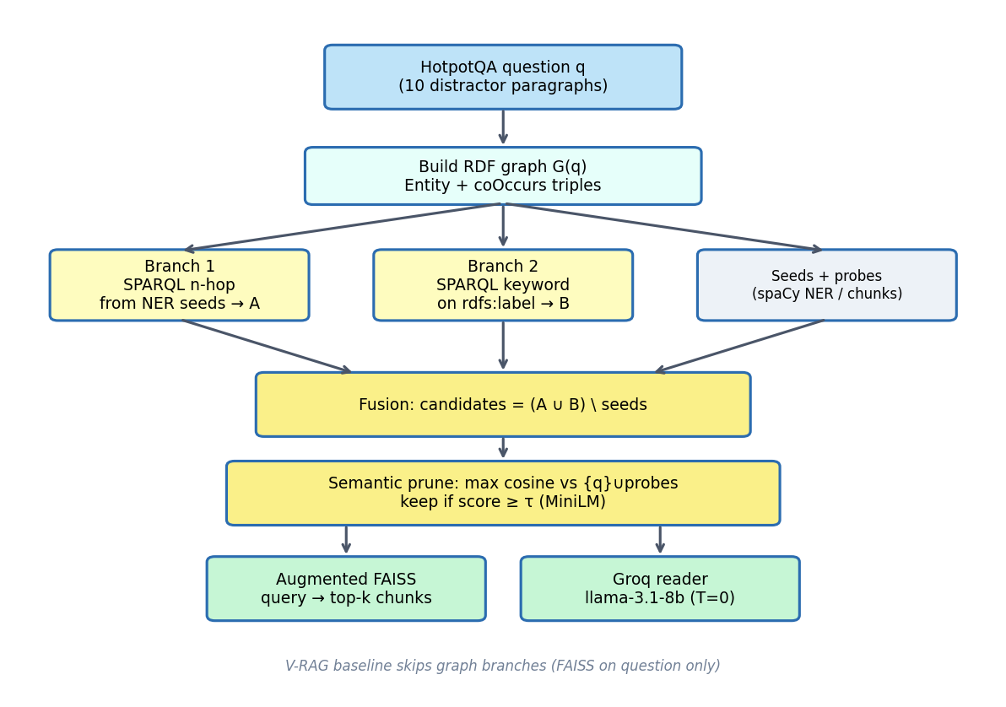
Method — top-down pipeline (two-branch logic)

Slide 6
Method — RDF graph & SPARQL branches
Graph: spaCy entities + symmetric spg:coOccurs within sentences + rdfs:label.
Branch 1: bounded property paths from NER seeds (n hops) → set A.
Branch 2: CONTAINS filters on labels from noun-chunk keywords → set B.
Default protocol: n=2, τ=0.5; heatmap sweep n∈{1,2,3}, τ∈{0.3…0.7}.

Slide 7
Baselines (same index + reader)
Pipeline | Graph | Role
V-RAG | — | Dense retrieval on question only
GQE-RAG (n=2) | Branch 1 | Structural expansion, no τ prune
SP-GQE (n=2, τ=0.5) | A ∪ B + prune | Primary system
SP-GQE-i (n=3, τ=0.5) | Iterative B1 | Ablated variant
GR-RAG / GF-RAG | Lexical | Graph-adjacent controls

Slide 8
Evaluation design
Primary metric: token F1; secondary: EM, supporting-title recall@k, P@k.
Paired ΔF1: SP-GQE − V-RAG with bootstrap 95% CI (bridge / comparison).
Graph-query validity: P/R vs gold supporting NER at 4 stages.
Aggregation: mean ± 95% CI across seed-level means; multi-day daily_runs JSON.
680
question instances (full study)
562
questions (semester preliminary)

Slide 9
Results — experiment scale
680
questions
28
seeds
24
heatmap seeds
580
heatmap weight
Reader: Groq llama-3.1-8b-instant (T=0). Embeddings: all-MiniLM-L6-v2.
Merged-grid best: n=1, τ=0.6 (pooled F1=0.577).
Protocol-default SP-GQE (2, 0.5) used for validity & appendix paired tests.

Slide 10
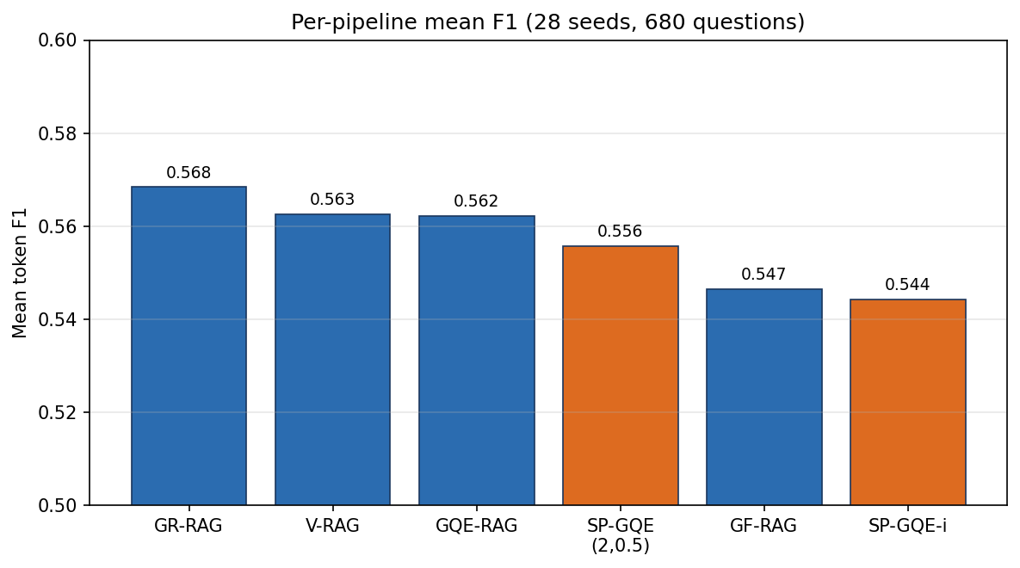
Results — mean token F1 by pipeline
28 seeds, 680 questions; error bars = 95% CI on seed means in aggregate tables

Slide 11
Results — pipeline table (28 seeds)
Pipeline | Mean F1 | 95% CI | P@k
GR-RAG | 0.5684 | [0.536, 0.600] | 0.6718
V-RAG | 0.5626 | [0.531, 0.594] | 0.6718
GQE-RAG(n=2) | 0.5622 | [0.527, 0.597] | 0.6630
SP-GQE(n=2,τ=0.5) | 0.5557 | [0.528, 0.584] | 0.6344
SP-GQE(n=1,τ=0.6)* | 0.5778 | [0.550, 0.605] | 0.6469

Slide 12
Results — SP-GQE(2,0.5) − V-RAG paired ΔF1
Subset | Mean Δ | Bootstrap 95% CI | n pairs
bridge | -0.0034 | [-0.028, 0.021] | 327
comparison | -0.0086 | [-0.038, 0.020] | 353
CIs include zero → no statistically reliable F1 gain vs V-RAG at this scale (H1 not confirmed).

Slide 13
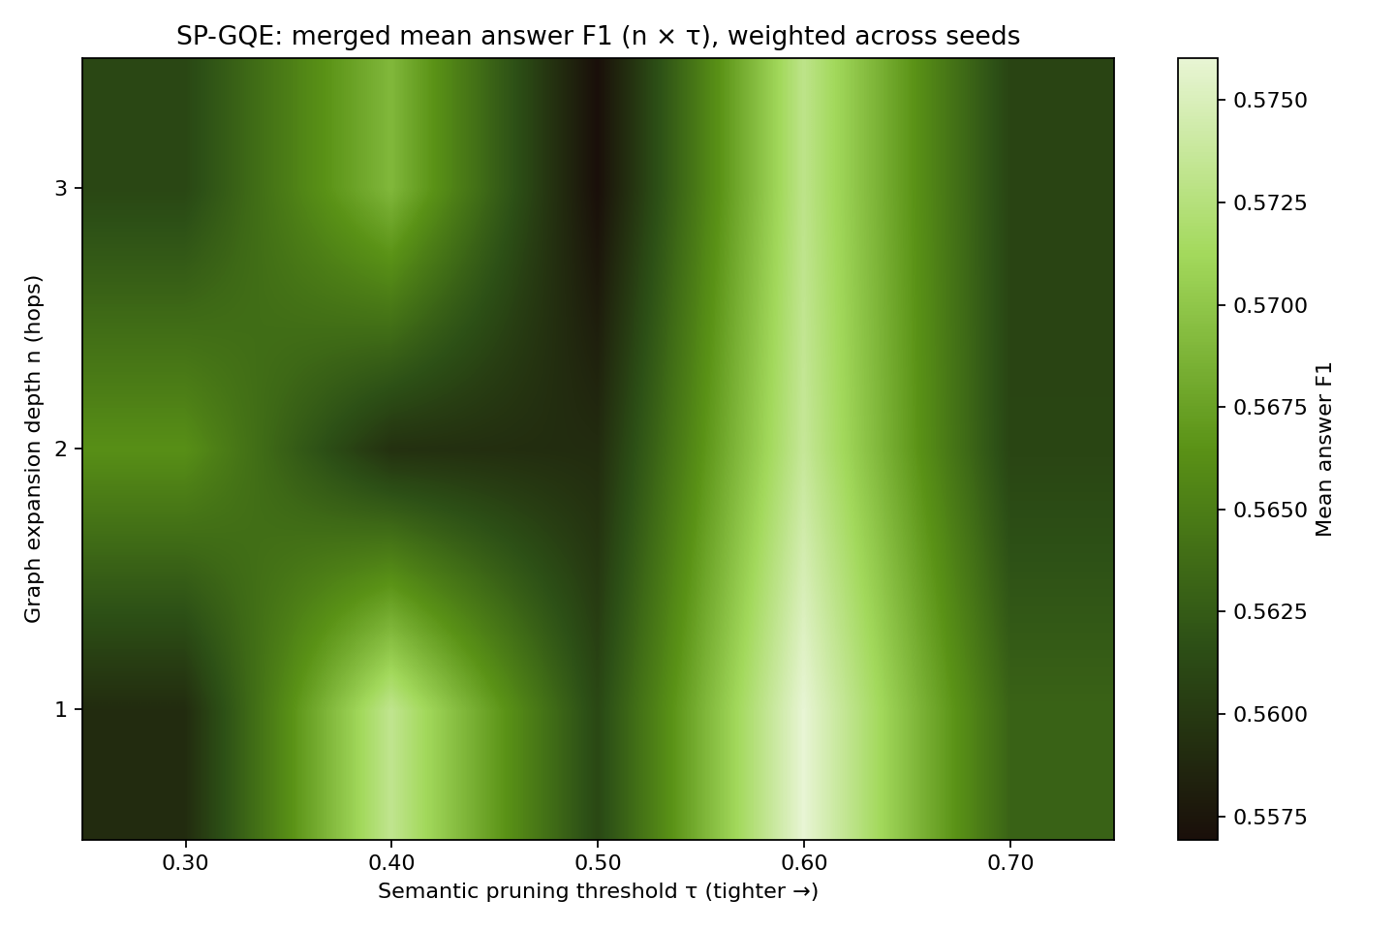
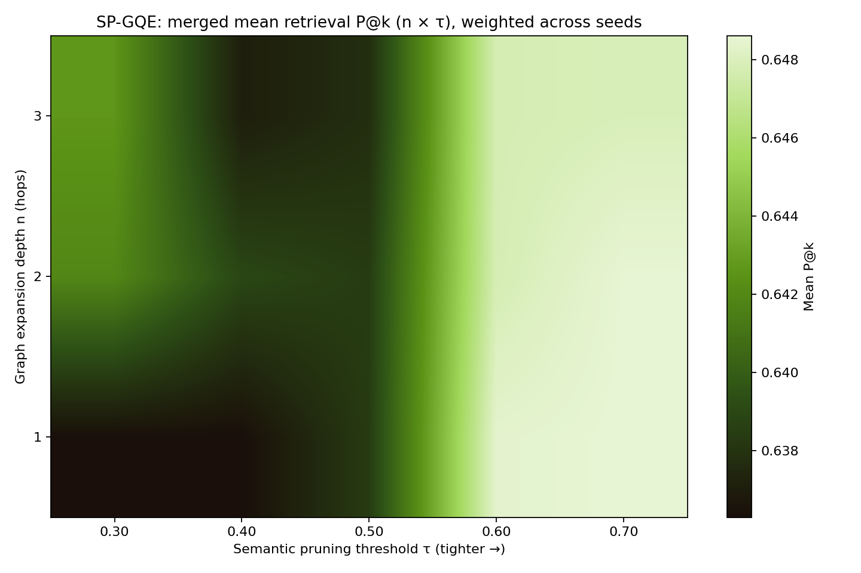
Results — merged (n, τ) heatmaps (weight=580)
Argmax pooled F1 → n*=1, τ*=0.6 (SP-GQE mean F1=0.5778 on 24 heatmap seeds)

Slide 14
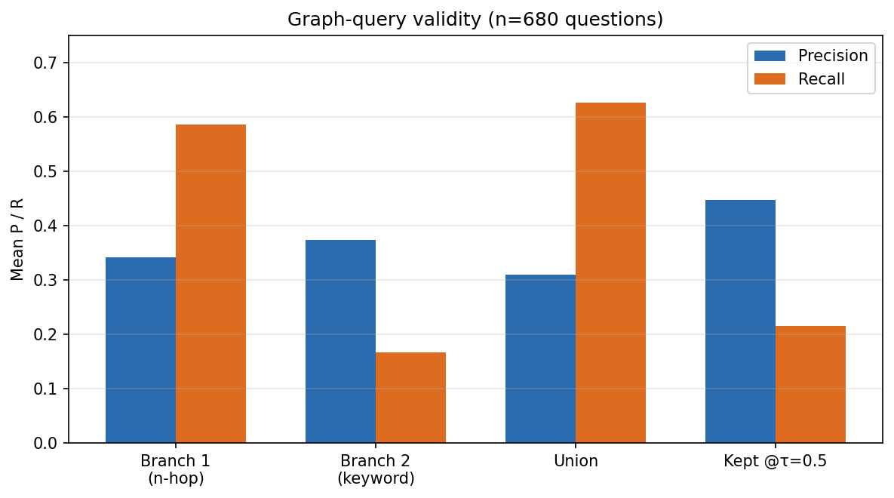
Results — graph-query validity (680 questions)
Union recall > Branch 2 alone → branches are complementary.
τ=0.5 increases precision, lowers recall → pruning trade-off.

Slide 15
SPARQL sample 1: [comparison]
Which of the following bands is considered "one of the most accomplished and creative Christian b…
Gold: Poor Old Lu | F1 SP-GQE / V-RAG: 1.000 / 1.000
Branch 1: structural n-hop (SPARQL)
PREFIX spg: <http://spgqe.local/> SELECT DISTINCT ?t WHERE { VALUES ?s { <http://spgqe.local/e#the_90s> <http://spgqe.local/e#christian> <http://spgqe.local/e#one> } { ?s spg:coOccurs ?t } UNION { ?s spg:coOccurs/spg:coOccurs ?t } }
Results (n=32): ['1854', '1990s', '2005', '6009', '9', '90s', 's", ', ', ', ', ', ', ', … (+14 more)]
Fusion, pruning & validity
Union |A∪B| = 35
Kept @τ=0.5 (n=9): ['christian', 'contemporary christian music', 'lu', 'one', 'poor old man', 'shudder to think', '90s", ', ', ']
Top cosine: shudder to think (0.841), lu (0.715), contemporary christian music (0.694), the poor old (0.573)
Validity: Branch 1 (n-hop): P=0.219 R=0.467 | Branch 2 (keyword): P=0.286 R=0.133 | Union: P=0.200 R=0.467 | Kept after τ: P=0.556 R=0.333
Branch 2: keyword / semantic (SPARQL)
PREFIX spg: <http://spgqe.local/> PREFIX rdfs: <http://www.w3.org/2000/01/rdf-schema#> SELECT DISTINCT ?e ?label WHERE { ?e a spg:Entity ; rdfs:label ?label . FILTER(CONTAINS(LCASE(STR(?label)), "following") || CONTAINS(LCASE(STR(?label)), "bands") || CONTAINS(LCASE(STR(?label)), "accomplished") || CONTAINS(LCASE(STR(?label)), "creative") || CONTAINS(LCASE(STR(?label)), "christian") || CONTAINS(LCASE(STR(?label)), "poor") || CONTAINS(LCASE(STR(?label)), "old") || CONTAINS(LCASE(STR(?label)), "shudder")) }
Results (n=7): ['a poor old man', 'christian', 'contemporary christian music', 'poor old man', 'shudder to think', 'the poor old', 'the poor old lady']

Slide 16
SPARQL sample 2: [comparison]
Which band, A Silent Film or The Frames, has more members?
Gold: The Frames | F1 SP-GQE / V-RAG: 1.000 / 1.000
Branch 1: structural n-hop (SPARQL)
PREFIX spg: <http://spgqe.local/> SELECT DISTINCT ?t WHERE { VALUES ?s { <http://spgqe.local/e#frames> } { ?s spg:coOccurs ?t } UNION { ?s spg:coOccurs/spg:coOccurs ?t } }
Results (n=6): ['1990', 'dublin', 'frames', 'glen hansard', 'irish', 'six']
Fusion, pruning & validity
Union |A∪B| = 11
Kept @τ=0.5 (n=6): ['a_frames', 'frames', 'pordenone silent film festival', 'silent songs', 'the niles silent film museum', 'the pordenone silent film festival']
Top cosine: a_frames (0.769), the pordenone silent film festival (0.686), silent songs (0.662), pordenone silent film festival (0.651)
Validity: Branch 1 (n-hop): P=1.000 R=0.286 | Branch 2 (keyword): P=0.167 R=0.048 | Union: P=0.545 R=0.286 | Kept after τ: P=0.167 R=0.048
Branch 2: keyword / semantic (SPARQL)
PREFIX spg: <http://spgqe.local/> PREFIX rdfs: <http://www.w3.org/2000/01/rdf-schema#> SELECT DISTINCT ?e ?label WHERE { ?e a spg:Entity ; rdfs:label ?label . FILTER(CONTAINS(LCASE(STR(?label)), "band") || CONTAINS(LCASE(STR(?label)), "silent") || CONTAINS(LCASE(STR(?label)), "film") || CONTAINS(LCASE(STR(?label)), "frames") || CONTAINS(LCASE(STR(?label)), "members")) }
Results (n=6): ['a_frames', 'frames', 'pordenone silent film festival', 'silent songs', 'the niles silent film museum', 'the pordenone silent film festival']

Slide 17
Conclusions
Rigorous multi-seed study (680 Q, 28 seeds) under fair pipeline controls.
SP-GQE mechanism is inspectable (SPARQL + validity stages); branches complement at entity level.
Mean F1: GR-RAG / GQE-RAG competitive; protocol SP-GQE does not beat V-RAG reliably.
Tuned grid (n*=1, τ*=0.6) raises heatmap-seed F1 but paired CIs still span zero.
Future: per-question logging at (n*, τ*), SP-GQE-i heatmap arm, larger samples.

